Slide 1

CONNECT(); 2017
//DEMOS & REFERENCE APPS

Slide 2
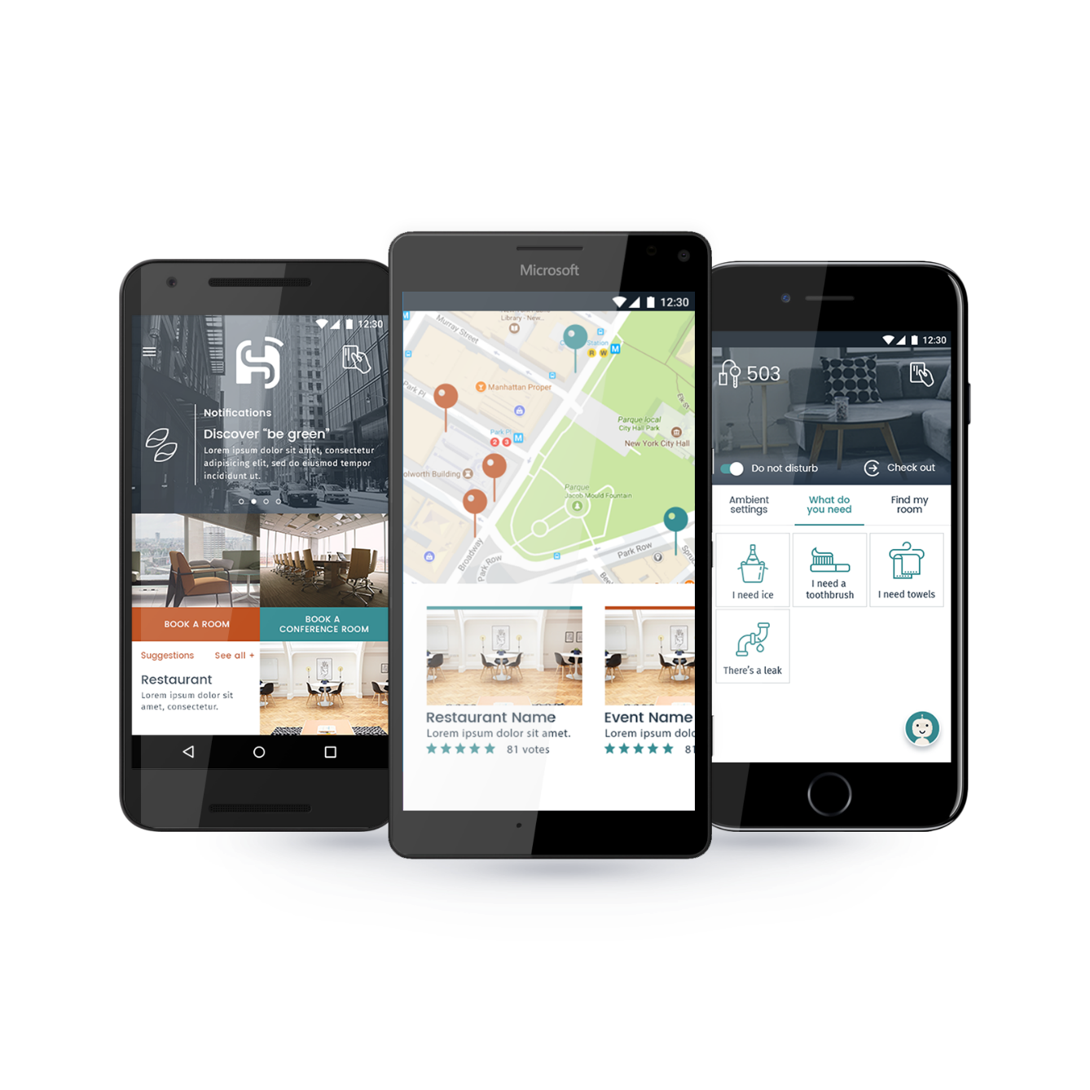
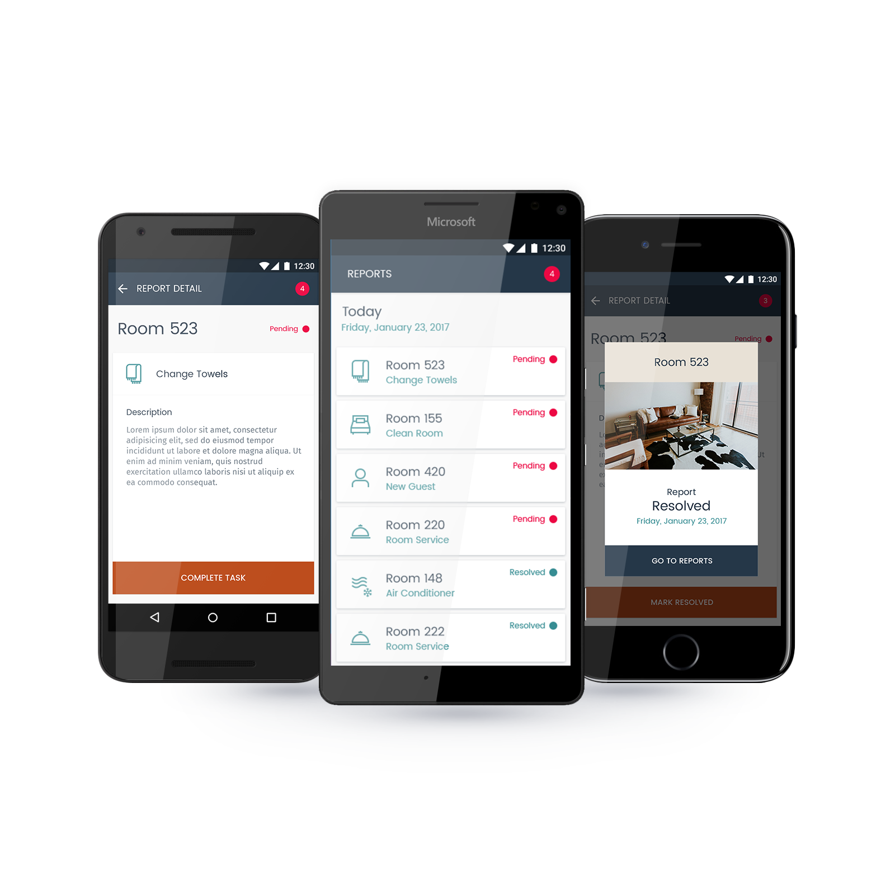

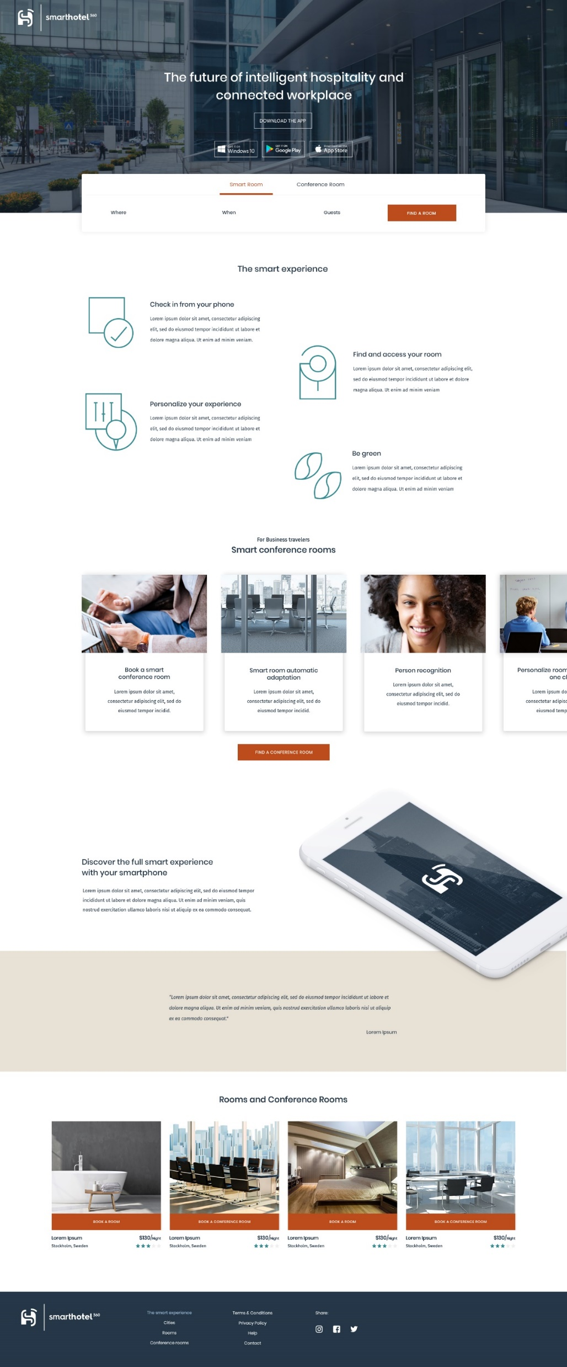
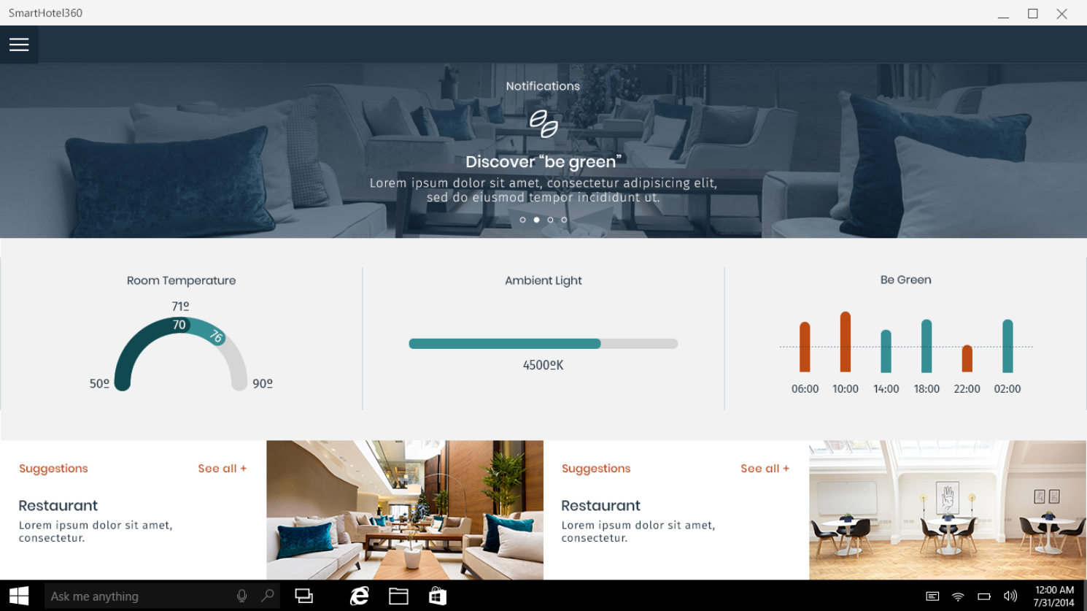
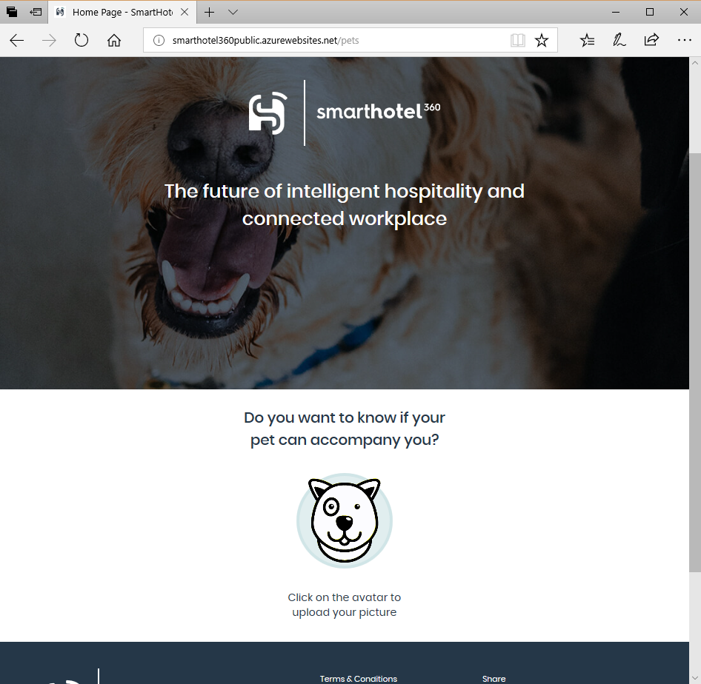
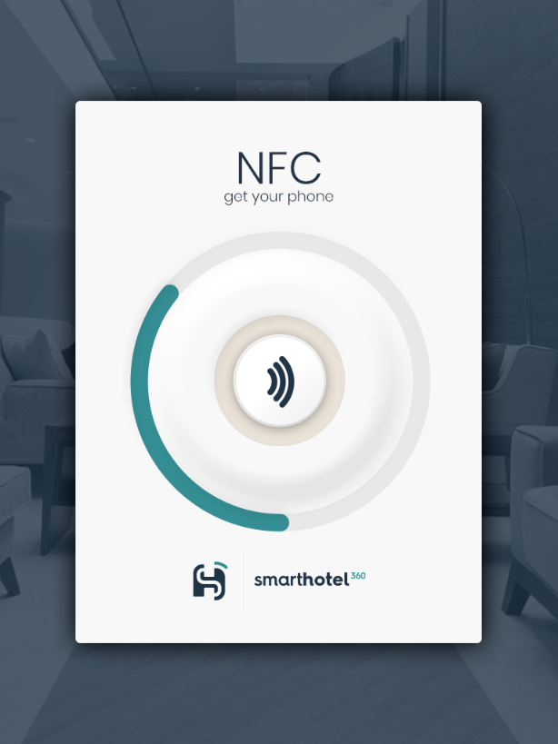
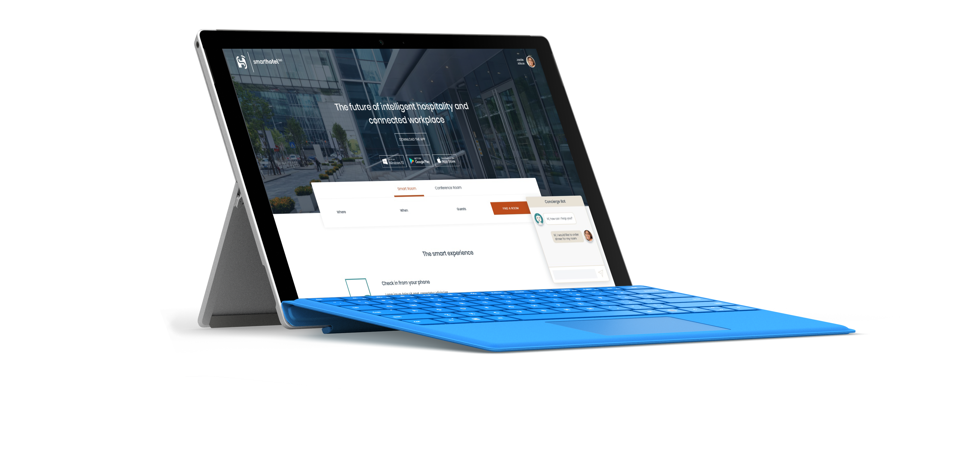
SmartHotel360 is a fictitious smart hospitality company showcasing the future of connected travel.
We built intelligent and personalized apps for guests, business travelers, and hotel managers. All powered by the cloud, our best-in-class tools, our data platform, and Artificial Intelligence.

Slide 3
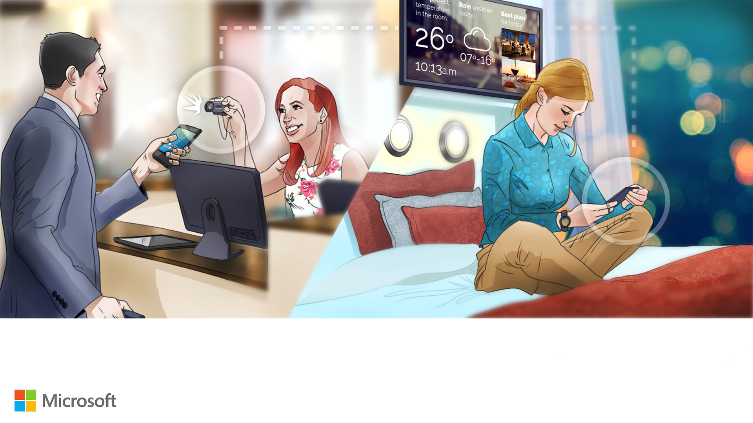
Their vision is to provide:
• Intelligent, conversational, and personalized apps and experiences to guests
• Modern workplace experiences and smart conference rooms for business travelers
• Real-time customer and business insights for hotel managers & investors
• Unified analytics and package deal recommendations for campaign managers.

Slide 4















Architecture Diagram
z
SmartHotel360 Customer App
NFC
AAD B2C
Azure Container Registry
z
Booking
Management
Kubernetes Cluster in Azure Container Service
Z
Bookings API
Hotel API
Maintenance app
Suggestions API
Config API
Notifications API
Tasks API
Public Web Site
Sentiment API
Reviews API
Azure Functions
Profiles API
Discounts API
Twitter
Sentiment Analysis using
Cognitive Services
z
Sentiment App
Azure Cosmos DB
(Twitter Sentiment
staging for apps)
Azure SQL DB
(Hotels)
Azure Databricks
(Package Deal Recommendations)
Azure SQL DB
(Bookings)
Azure SQL DB R services
(Suggestions)
Azure DB
for MySQL

Slide 5

Thank you!

